Slide 1
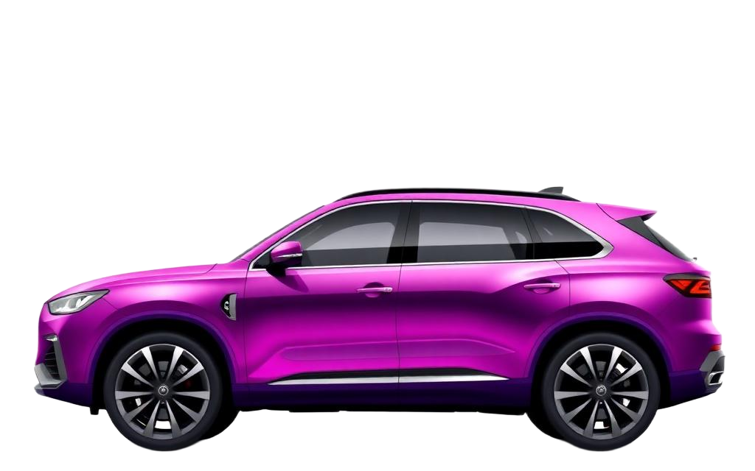
CASE STUDY • 2026
BRIGHT MOTORS
ANALYSIS
Created by Mogau Mabula
Business Insights for the New Head of Sales
DATA • INSIGHT • STRATEGY
A data-driven look at revenue, performance and growth opportunities across the Bright Motors dealership network.

Slide 2
CONTENTS
What we'll cover
▸ 01 Executive Summary
▸ 02 Business Context & Objectives
▸ 03 Headline KPIs
▸ 04 Revenue Trends Over Time
▸ 05 Top Performing Models
▸ 06 Profit Margin Distribution
▸ 07 Geographic Performance
▸ 08 Weekly Sales Patterns
▸ 09 MMR vs Selling Price
▸ 10 Color & Body Preferences
▸ 11 Key Insights
▸ 12 Recommendations & Next Steps
BRIGHT MOTORS • Sales Analysis
2 / 15

Slide 3
EXECUTIVE SUMMARY
A profitable but uneven business
▸ Bright Motors generated $7.6 bn in revenue across 558.8k transactions.
▸ Market value of inventory ($7.7 bn) is closely aligned to revenue — pricing is on track.
▸ Ford F150 and Nissan Altima dominate sales; the top 5 models account for ~$967 m.
▸ 47% of revenue comes from Low-Margin deals — profitability is under pressure.
▸ Florida, California and Pennsylvania are the strongest revenue regions.
▸ Mid-week (Tue–Fri) is the peak selling window across every quarter.
THE BIG PICTURE
$7.6bn
in total revenue from 558.8k vehicle sales
FOCUS AREAS
Lift margins • Expand top regions • Optimise mid-week ops
BRIGHT MOTORS • Sales Analysis
3 / 15

Slide 4
BUSINESS CONTEXT
Why this analysis matters
▸ Bright Motors recently appointed a new Head of Sales.
▸ Mission: expand the dealership network, lift sales performance and optimise inventory.
▸ Source data: daily transactional & pricing records from the Bright Car Sales dataset.
▸ Goal of this deck: turn historical data into actionable strategy.
KEY QUESTIONS
▸ Which makes & models earn the most?
▸ How do price, mileage & year relate?
▸ Which regions sell the most?
▸ What trends are emerging?
▸ How can we lift profitability?
BRIGHT MOTORS • Sales Analysis
4 / 15

Slide 5
HEADLINE KPIS
The numbers that matter
TOTAL REVENUE
VEHICLES SOLD
MARKET VALUE (MMR)
AVG. SELLING PRICE
$7.6bn
558.8k
$7.7bn
~$13.6k
HIGH-MARGIN SHARE
TOP-5 MODELS REVENUE
#1 STATE
PEAK SELLING DAYS
10.1%
$967m
FL
Tue–Fri
Revenue is strong, but the margin mix and regional concentration tell the deeper story.
BRIGHT MOTORS • Sales Analysis
5 / 15

Slide 6
REVENUE TRENDS
Revenue by quarter, 2014 – 2015
INSIGHT
Sales surged from early 2014 into Q1 2015 — a ~12× lift driven by inventory expansion. A gradual taper through Q2–Q3 2015 suggests a normalisation phase, not a decline. Q1 remains the strongest selling quarter — plan inventory and marketing accordingly.
BRIGHT MOTORS • Sales Analysis
6 / 15

Slide 7
TOP PERFORMERS
Top 5 best-selling models
WHAT IT MEANS
• Ford F150 is the clear leader — pickup demand is strong.
• Nissan Altima follows closely — sedan loyalty remains.
• Top 5 = $967m (~13% of total revenue).
• Concentration risk: stock & promote beyond the top two.
BRIGHT MOTORS • Sales Analysis
7 / 15

Slide 8
PROFIT MIX
Revenue share by profit category
THE MARGIN PROBLEM
Nearly half of revenue is low-margin
▸ Only 1 in 10 deals are High Margin.
▸ Medium + Low margin make up 89.9% of revenue.
▸ A small lift in High-Margin share would meaningfully grow profit.
BRIGHT MOTORS • Sales Analysis
8 / 15

Slide 9
GEOGRAPHIC PERFORMANCE
Top 10 states by revenue
REGIONAL STORY
Florida and California together generate ~$2.15 bn — over a quarter of total revenue. Pennsylvania is a strong third, signalling demand in the Northeast. Mid-tier states (TX, GA, NJ) are clear expansion targets for new dealerships.
BRIGHT MOTORS • Sales Analysis
9 / 15

Slide 10
WEEKLY PATTERNS
Average MMR by day of week
OPERATIONAL INSIGHT
Tuesday and Friday are peak trading days. Sunday volumes drop sharply — many showrooms quiet. Action: Staff and promotions should be weighted Tue–Fri; consider Sunday pop-up events.
BRIGHT MOTORS • Sales Analysis
10 / 15

Slide 11
PRICING HEALTH
MMR vs Selling Price by quarter
PRICING HEALTH
Selling Price tracks MMR closely — pricing is disciplined. A small but consistent gap below MMR means money is being left on the table. Tightening discounts by even 1–2% would directly boost margin.
BRIGHT MOTORS • Sales Analysis
11 / 15

Slide 12
CUSTOMER PREFERENCES
Color & body-style mix
Sales by exterior colour
Share by body type — Sedans & SUVs lead
BRIGHT MOTORS • Sales Analysis
12 / 15

Slide 13
KEY INSIGHTS
What the data is telling us
01
Revenue is concentrated.
Top 5 models = $967m, 2 states = $2.15bn. Diversify the bench.
02
Margins are the weak link.
Only 10% of revenue is High Margin — pricing & cost discipline needed.
03
Trading is a weekday game.
Tue–Fri drive the bulk of MMR — align staffing & promos.
04
Q1 is peak season.
Inventory and marketing should peak in early-quarter months.
05
Pricing is disciplined.
Selling price closely tracks MMR — a small uplift goes straight to profit.
BRIGHT MOTORS • Sales Analysis
13 / 15

Slide 14
RECOMMENDATIONS
Actions for the new Head of Sales
Lift Margin Mix
Expand Smartly
Optimise Operations
▸ Set a target to grow High-Margin share from 10% to 15% in 12 months.
▸ Train sales teams on value-based selling, not just price-cutting.
▸ Tighten discount approval thresholds.
▸ Open new dealerships in TX, GA and NJ — high-potential mid-tier states.
▸ Defend market leadership in FL, CA and PA with loyalty programmes.
▸ Weight staffing & promotions toward Tue–Fri.
▸ Pilot Sunday community events to test weekend demand.
▸ Stock-up on F150 and Altima ahead of Q1 each year.
BRIGHT MOTORS • Sales Analysis
14 / 15

Slide 15
Thank you.
Questions & discussion.
Created by Mogau Mabula
Bright Motors • Sales Analysis • 2026

